Slide 1
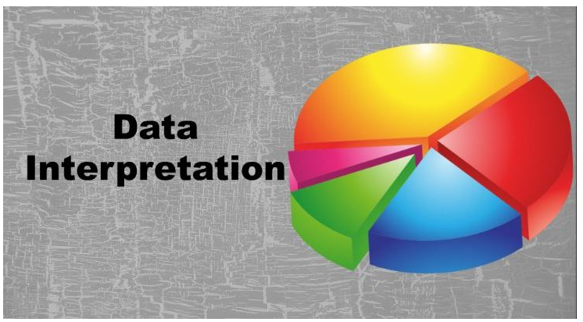
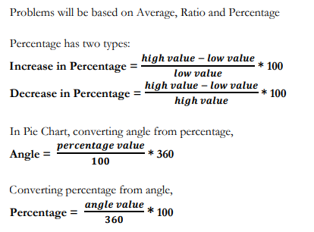

Slide 2
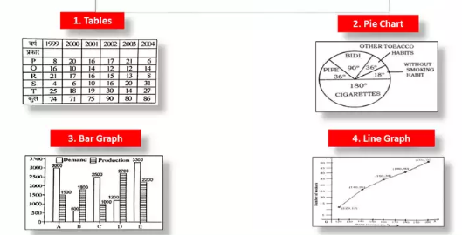
Types Of Data Interpretation

Slide 4
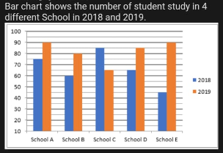

1) Find the average number of student in the school A, B and E together in 2018? a) 60 b)75 c)70 d)64

Slide 5

2) Find ratio of number of students of School B & C together in 2018 to that School A & D together in 2019? a) 25 : 29 b) 25 : 27 c) 29 : 35 d) 24 : 37 e) 2 : 3

Slide 6

3) Number of student in School A and E together in 2019 is what percent more/less than that of students in School B in 2018? a) 125% b) 200% c) 175% d) 75% e) 100%

Slide 7

4) Find the difference between the average number of students in School A and C together in 2019 and that of Students of School B and D together in 2018? a) 25 b) 10 c) 18 d) 20 e) 15

Slide 8

5) Number of student study in School A & D together in 2018 is what percent of number of student study in School B in 2019? a) 175% b) 125% c) 220% d) 210%

Slide 9
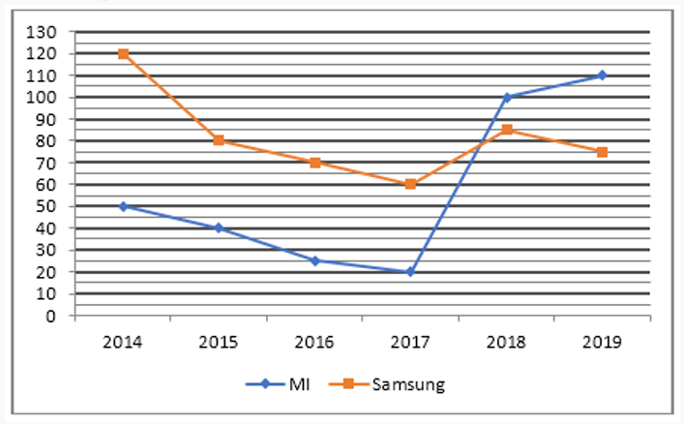
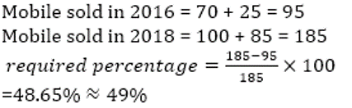
1) Mobiles (MI and Samsung both) sold in year 2016 is what percent more/less than that of in year 2018? (Approximately) a) 45% b) 58% c) 40% d) 49% e) 35

Slide 10
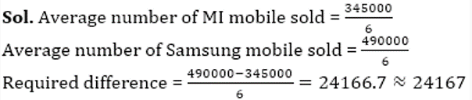
Find out the difference between average of all mobile sold of MI and that of samsung in all given years?(Approximately) a) 26666 b) 32333 c) 28177 d) 24167

Slide 11

What is the ratio of sold mobile of MI in 2017 & 2018 together to the that of Samsung mobile in 2014 & 2015 together? a) 5 : 3 b) 3 : 5 c) 5 : 7 d) 4 : 7

Slide 12
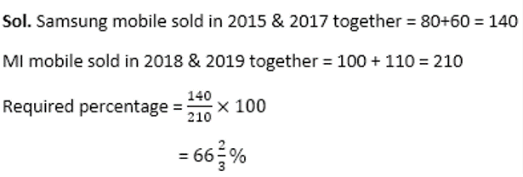
Samsung Mobile sold in 2015 & 2017 together is what percent of MI mobile sold in 2018 & 2019 together ? a) 66 2/3% b)60% c) 54% d) 75%

Slide 13
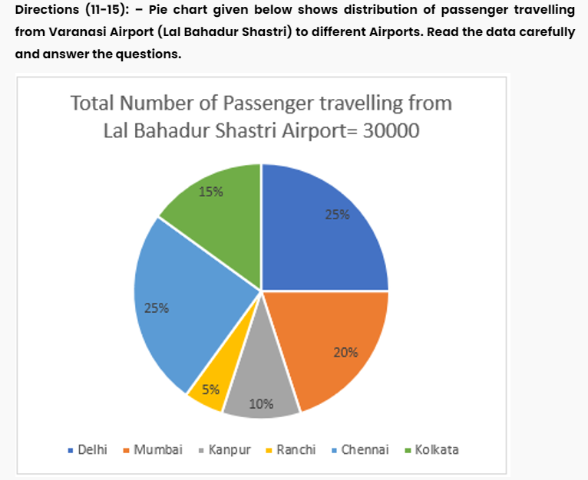

Number of passenger who are travelling from Varanasi to Delhi is how much percent more/less than that of who are travelling to Mumbai? a) 25% b) 28% c) 30% d) 45% e) 40%

Slide 14

Find out the average number of travellers who are travelling from Varanasi to Mumbai, Kanpur and Ranchi? a) 3250 b) 2756 c) 3500 d) 3450 e) 3050

Slide 15

Number of passengers who travelling from Varanasi to Delhi and Mumbai together is what percent of number of passengers who travelling from Varanasi to Kolkata? a) 200% b) 225% c) 175% d) 250% e) 300%

Slide 16
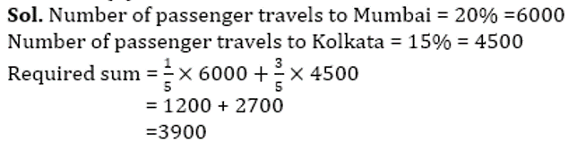
If the number of Indian and foreigner travelling from Varanasi to Mumbai and Kolkata is in the ratio of 4:1 and 3:2 respectively, then find out the sum of number of foreigner passenger travelling to Mumbai and Indian Passenger travelling to Kolkata? a) 2700 b) 2500 c) 3700 d) 3900 e) 2800

Slide 17

Find out the ratio of number of passengers who travelling to Ranchi and Kanpur together to that of Chennai? a) 1:3 b) 2:3 c) 3:2 d) 3:5 e) 3:1

Slide 18
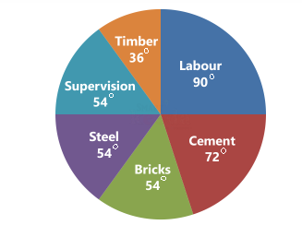
The amount spent on cement is a) 20000 b) 16000 c) 12000 d) 10000
Total cost = Rs. 60000 Amount spent on cement =
The pie chart given below shows the break-up of the cost of construction of a house (in degrees). Assuming that the total cost of construction is Rs. 60000, answer the questions given below.
72 | × 60000 = 12000
360

Slide 19
The amount spent on bricks, steel and cement is what percentage of the total cost of construction? a) 50% b) 54% c) 72% d) 75%
Amount spent on bricks, steel and cement
= [(54+54+72)/360]*100
= 50%
The pie chart given below shows the break-up of the cost of construction of a house (in degrees). Assuming that the total cost of construction is Rs. 60000, answer the questions given below.

Slide 20
The amount spent on labour exceeds the amount spent on steel by a) 5% of the total cost b) 10% of the total cost c) 12% of the total cost d) 15% of the total cost
Diff = Labour – Steel = 90 - 54 = 36
Percentage = ( 36/ 360 ) *100
= 10 %
The pie chart given below shows the break-up of the cost of construction of a house (in degrees). Assuming that the total cost of construction is Rs. 60000, answer the questions given below.

Slide 21
The amount spent on timber is what percent of the amount spent on cement? a) 36% b) 50% c) 72% d) 18%
% of amount spent on timber with respect to the amount spent on cement = (36/72)*100
= 50%
The pie chart given below shows the break-up of the cost of construction of a house (in degrees). Assuming that the total cost of construction is Rs. 60000, answer the questions given below.

Slide 22
What is the ratio of the combined expenditure on Supervision and Timber to the combined expenditure on Bricks and Cement? A) 7:5 b) 3:4 c) 4:3 d) 5:7
Supervision + Timber = 54 + 36 = 90
Bricks + Cement = 54 + 72 = 126
So the answer = 90 : 126 = 5 : 7
The pie chart given below shows the break-up of the cost of construction of a house (in degrees). Assuming that the total cost of construction is Rs. 60000, answer the questions given below.

Slide 23
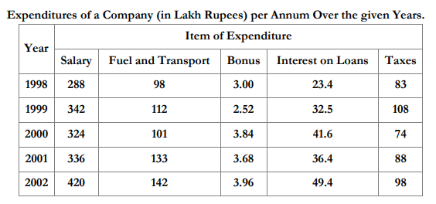
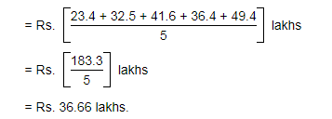
What is the average amount of interest per year which the company had to pay during this period? a) 32.43 lakh b) 33.72 lakh c) 34.18 lakh d) 36.66 lakh

Slide 24
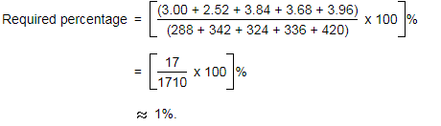
The total amount of bonus paid by the company during the given period is approximately what percent of the total amount of salary paid during this period? A. 0.1% B. 0.5% C. 1% D. 1.25%
The total amount of bonus paid by the company during the given period is approximately what percent of the total amount of salary paid during this period?

Slide 25
The total expenditure of the company over these items during the year 2000 is? A) Rs. 544.44 laks b) Rs. 501.11 laks c) Rs. 446.46 laks d)Rs. 478.87 laks
Total expenditure of the Company during 2000
= Rs. (324 + 101 + 3.84 + 41.6 + 74) lakhs
= Rs. 544.44 lakhs.
The total amount of bonus paid by the company during the given period is approximately what percent of the total amount of salary paid during this period?

Slide 26
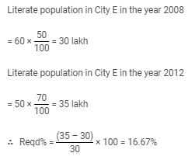
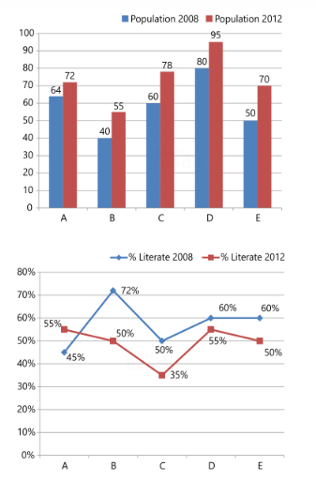
What is the percentage rise in the literate population of City E from the year 2008 to 2012?
The following bar graph shows the population (in lakh) of five cities in the years 2008 and 2012 and the line graph shows the percentage of literate among them

Slide 27

What is the percentage rise in the population of City A from the year 2008 to 2012?
The following bar graph shows the population (in lakh) of five cities in the years 2008 and 2012 and the line graph shows the percentage of literate among them

Slide 28
What is the total literate population of all cities together in the year 2008?
The following bar graph shows the population (in lakh) of five cities in the years 2008 and 2012 and the line graph shows the percentage of literate among them
Total literate population
= 45% of 64 + 72% of 40 + 50% of 60 + 60% of 80 + 60% of 50
= 28.8 + 28.8 + 30 + 48 + 30
= 165.6 lakh
= 1.656 crore

Slide 29


